Slide 1
Containers in Azure
Praveen S Rawat
Partner Tech Evangelist (ISV Stategy)
Questions: prrawa@microsoft.com

Slide 2
Session Objectives And Takeaways
Session Objective(s):
Understand core technologies on Azure that can be used to develop microservices and containerized apps
Takeaways:
Azure is an open platform
Azure presents a diverse set of options to build microservices
Azure promotes best tool for the job.

Slide 3

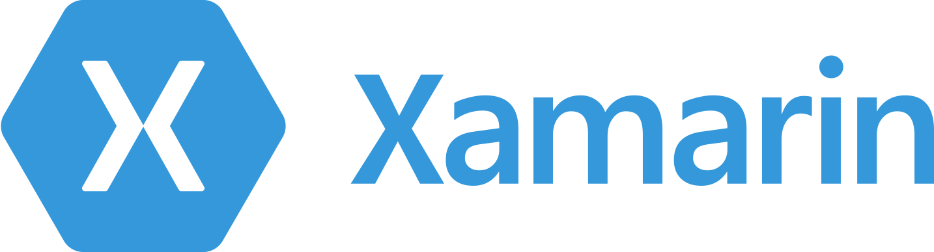





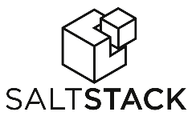











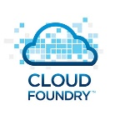
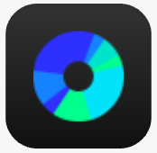














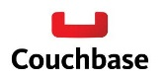






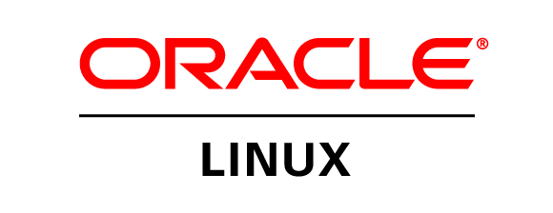
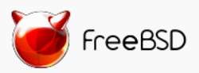

Azure is an open cloud
DevOps
Clients
Management
Applications
PaaS &
DevOps
App Frameworks
& Tools
Databases &
Middleware
Infrastructure

Slide 4
Microservices / Containerization Trends
Movement away from monolithic design into Microservices
Rise of containerization and docker
Developers need a heterogenous environment for development
Need to reduce infrastructure and operational cost
Standardize and modernize application architecture

Slide 5

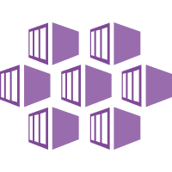
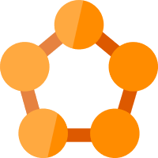


Deploy containers everywhere in Azure
Container Service
Service Fabric
Web Apps
Batch
Kubernetes
Mesos DC/OS
Docker Swarm

Slide 6
Azure Container Service

Slide 7

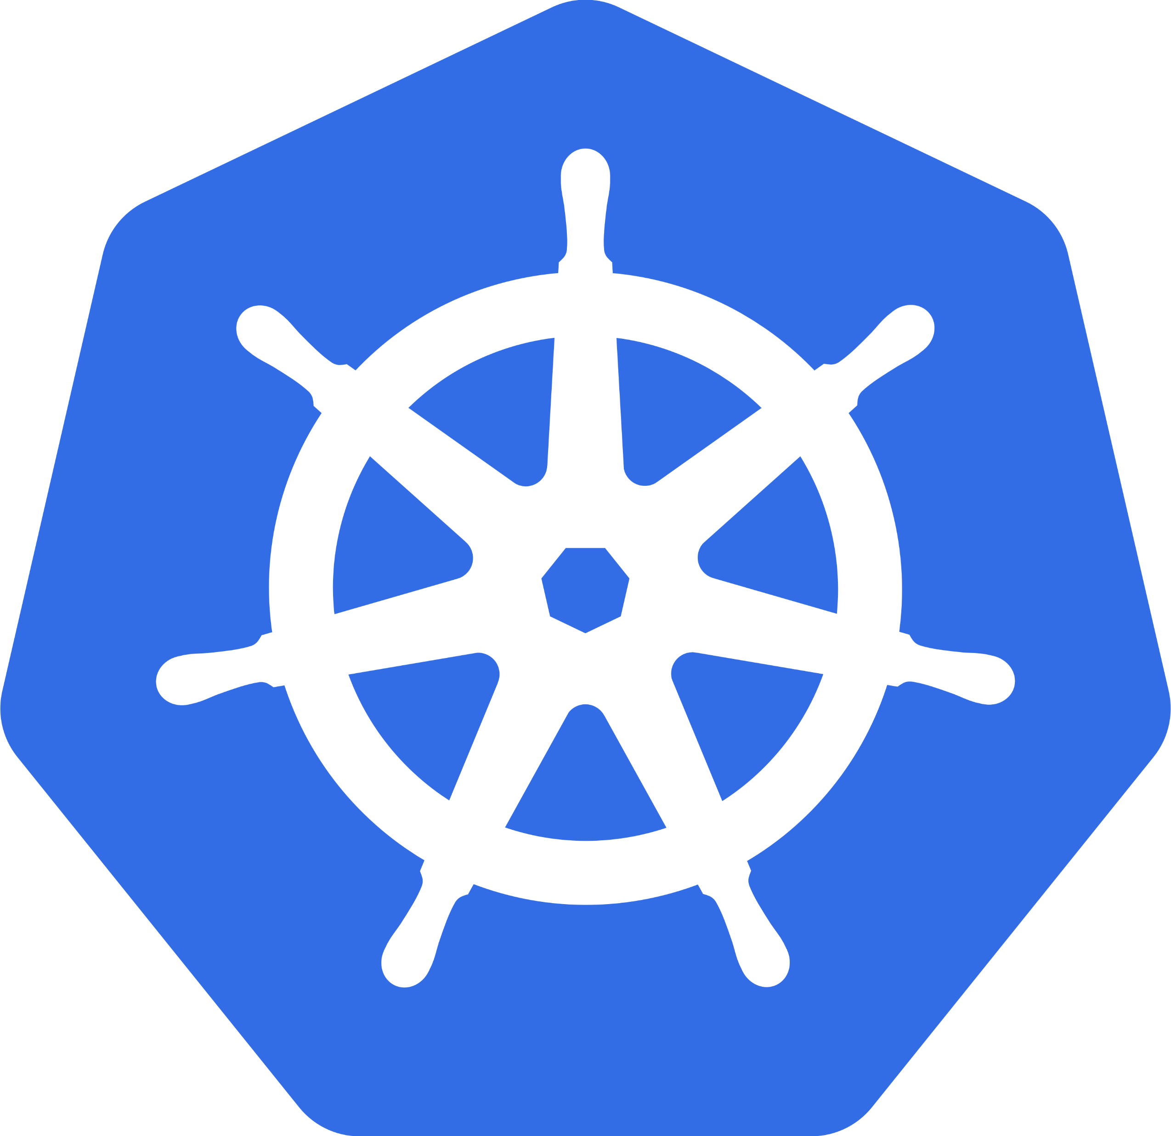
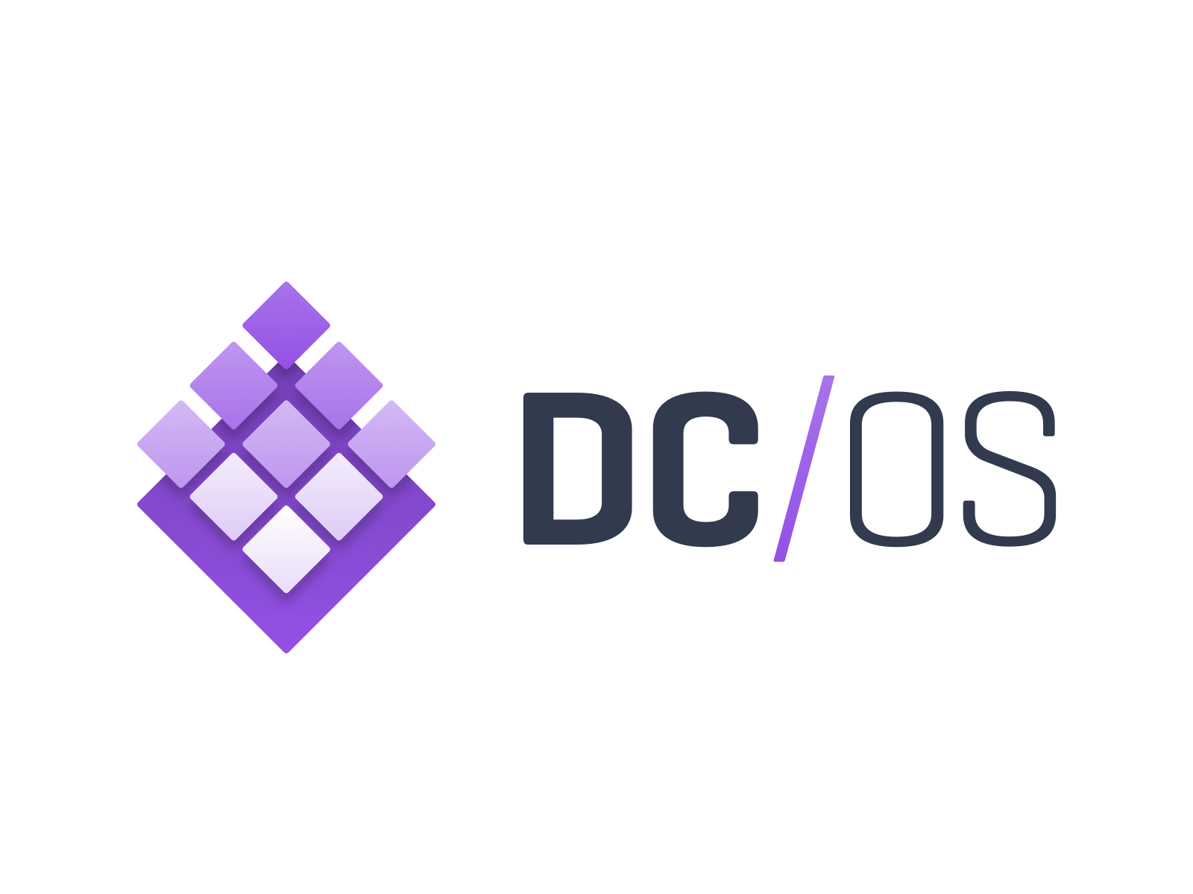
ACS: The best place to run your containers
Azure Container Service
Standard tooling and API support
Streamlined provisioning of DC/OS, Docker Swarm, and Kubernetes
Kubernetes
DC/OS
Swarm

Slide 8


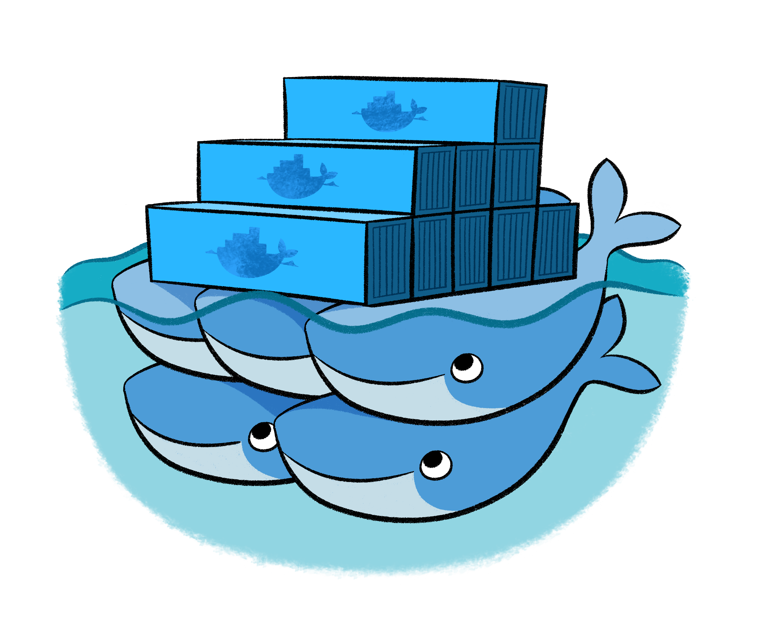
Azure Container Service
Application
Orchestrator
ARM
Kubernetes
Infrastructure

Slide 9
Azure Container Service
Service Tooling
Container Tooling
Layer | Supported Technologies
Configuration as Code | ARM, Dockerfile, Docker Compose, Marathon.json
Host cluster management | VM Scale Sets, Azure CLI
Container orchestration | Docker Swarm, Chronos, Marathon, Apache Mesos, Kubernetes
Monitoring | OMS, App Insights, Statsd, Splunk
ARM Template
Containers
Container Services (1st party, 3rd party)
Windows Server
Linux
VMs and VM Scale Sets
Azure Stack
Azure

Slide 10
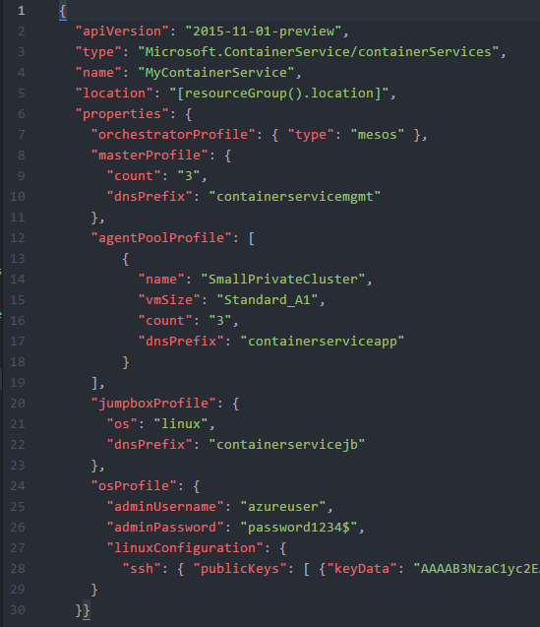
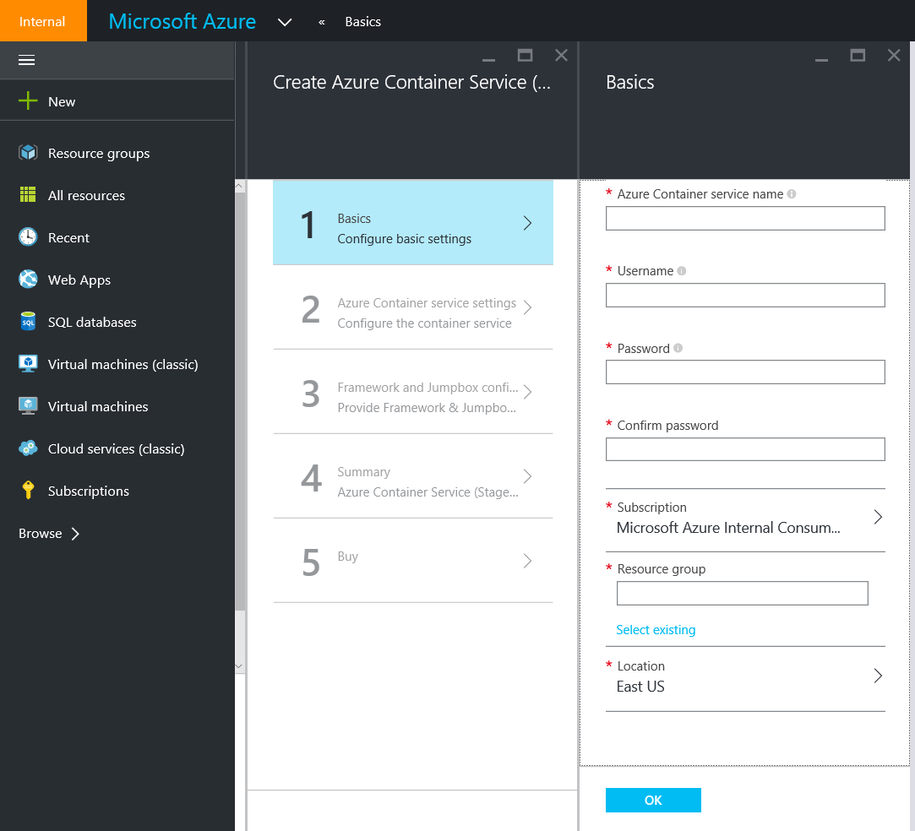
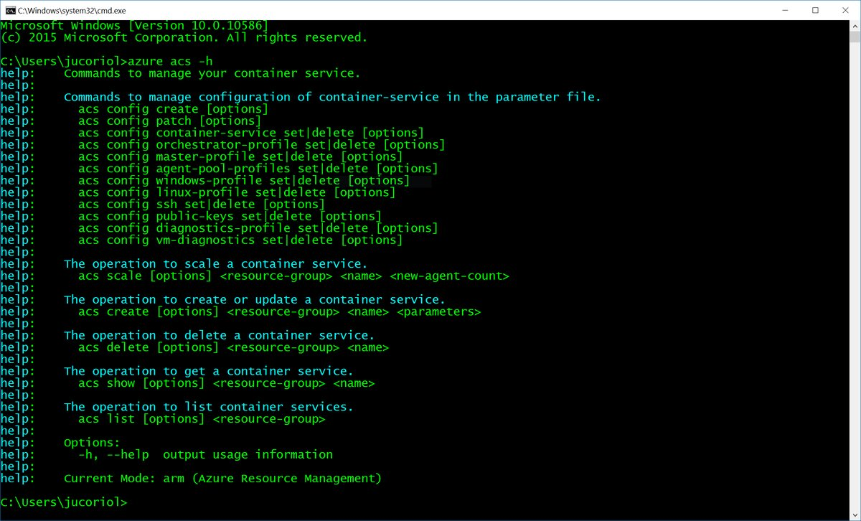
Deploy using Portal, CLI, or ARM

Slide 11
Building service based applications on ACS
ACS provides the infrastructure
No opinion on the Docker registry
Use the service of choice for Service Registry/Discovery
Docker overlay networks
Mesos-DNS, Minuteman (VIP)
Marathon-LB
App Gateway
3rd Party Solutions (NGINX)
Use your favorite CI/CD pipeline
Shared storage options
Use your favorite diagnostics/monitoring solution

Slide 12
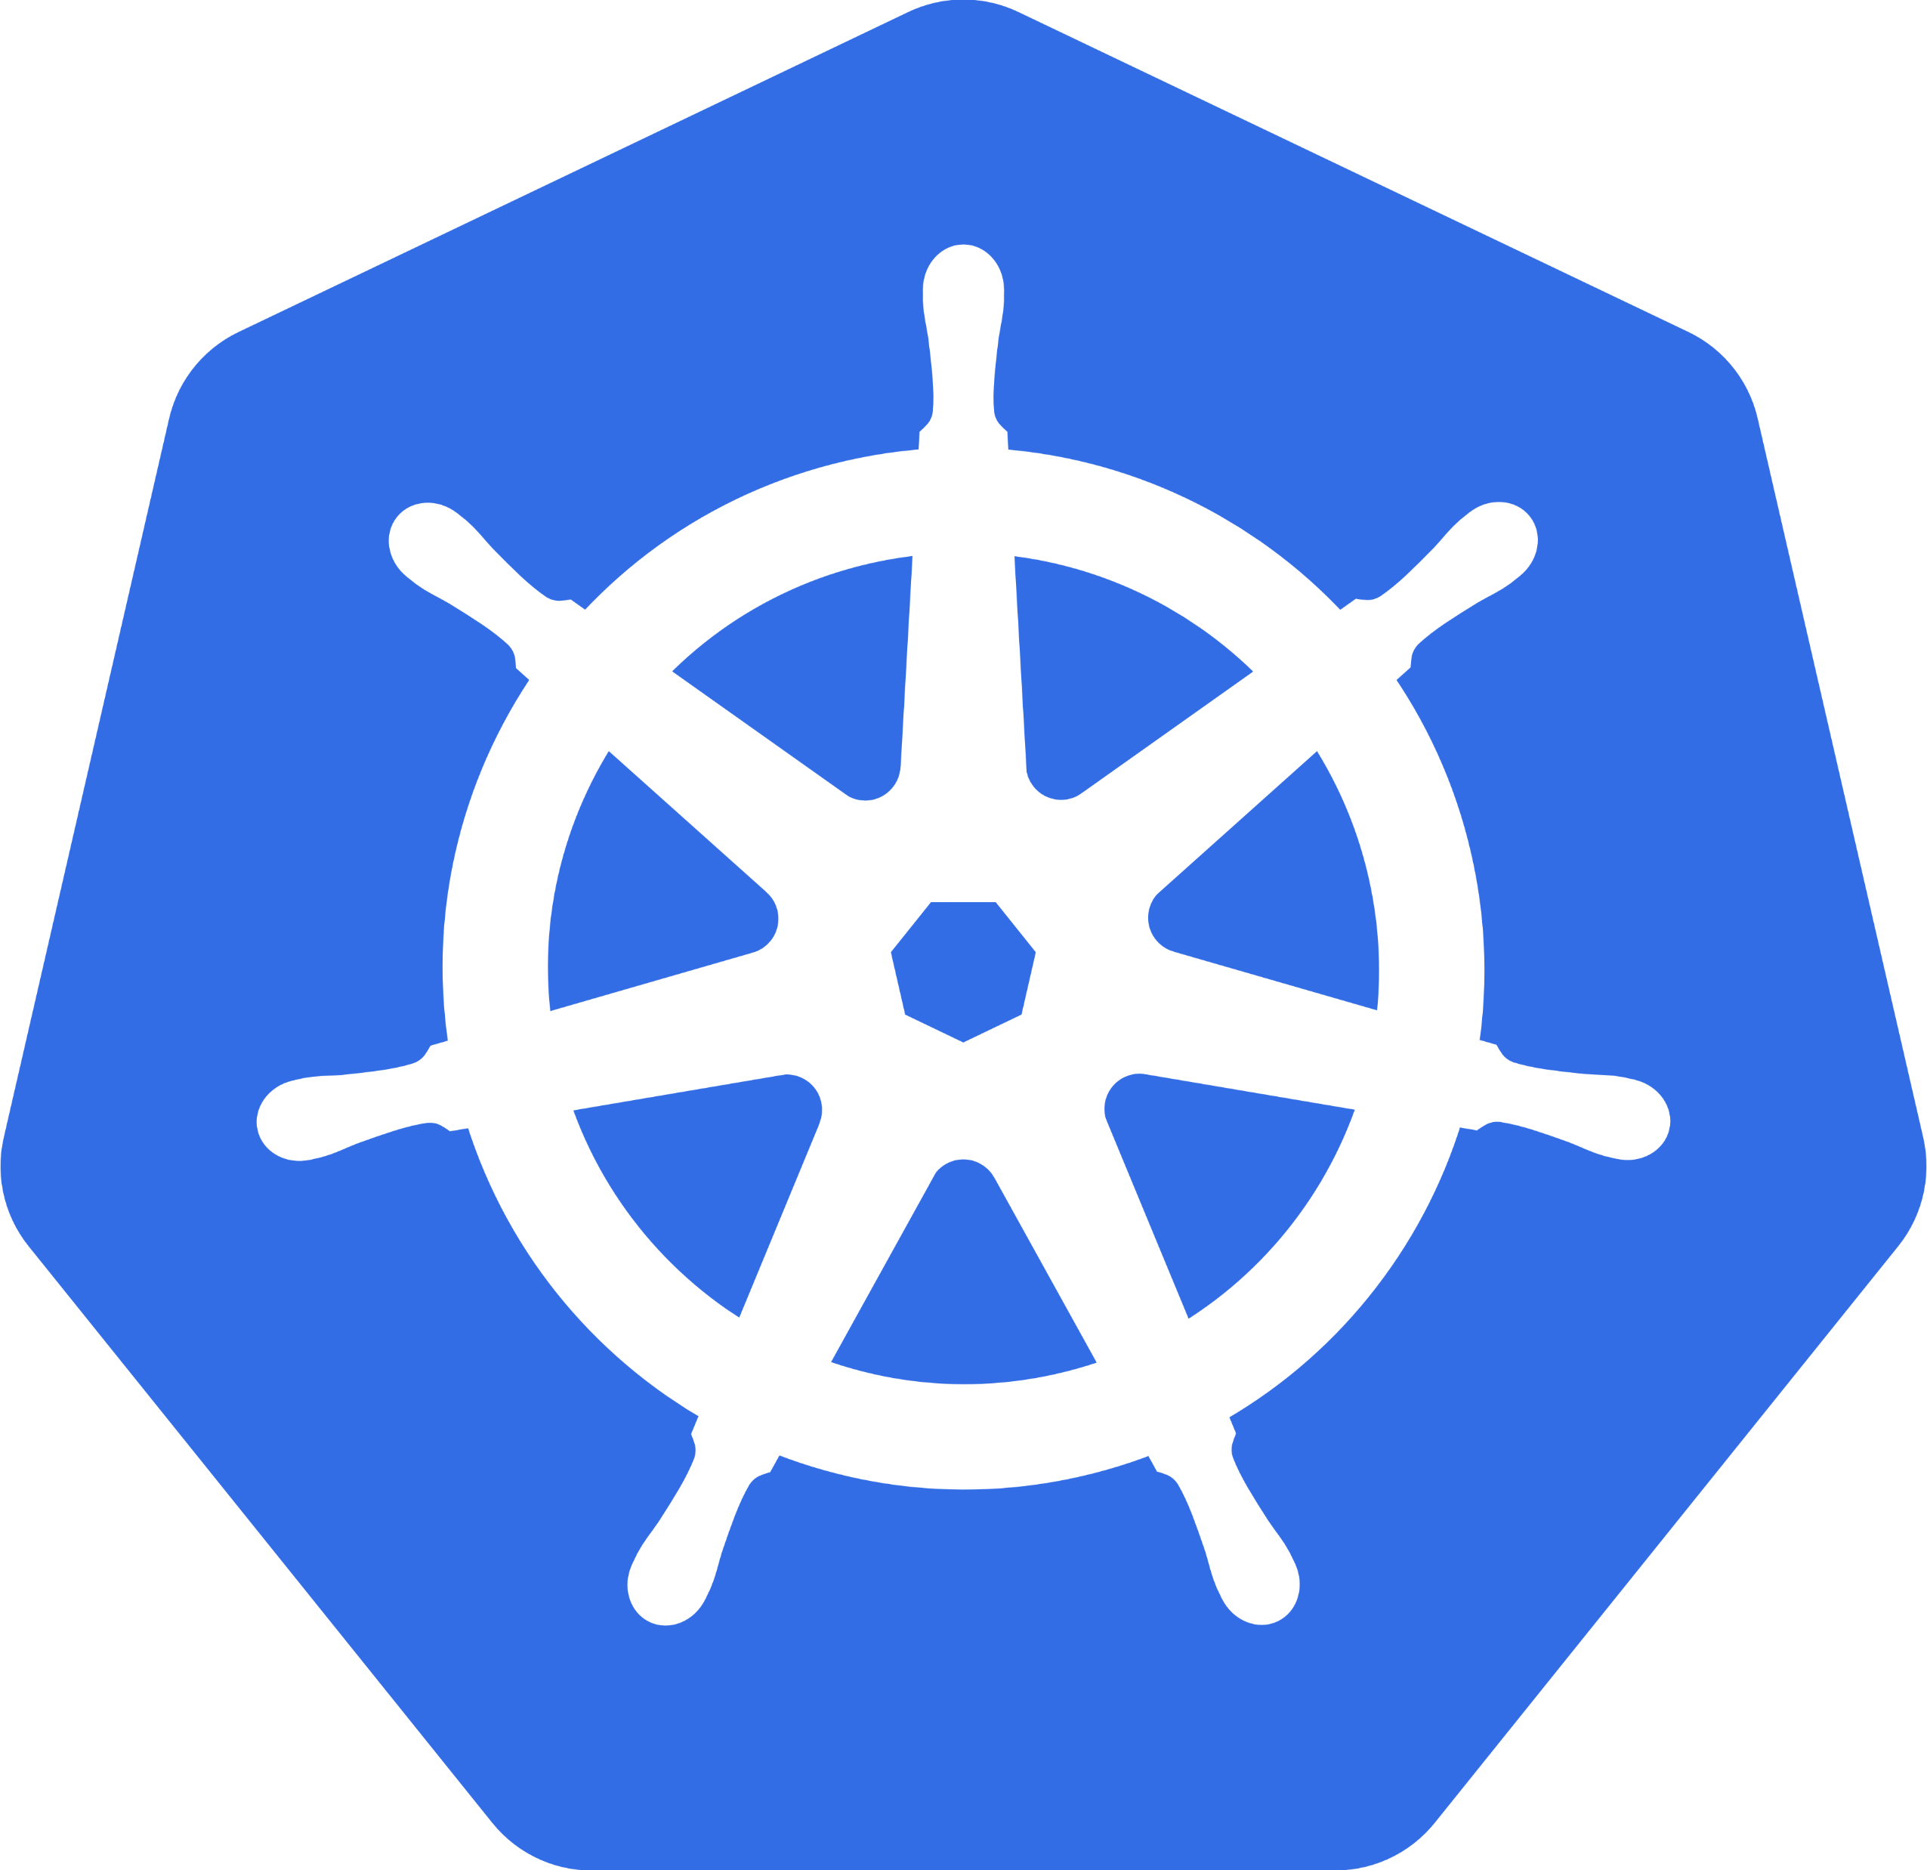
Kubernetes on ACS
CLI based deployment
Native Azure networking
Support for Azure L4 load balancing
Support for Azure Files + Pods
Multi-master deployment
VM/node scaling
Support for Azure virtual disk provisioning, mount/unmount
Ingress provider for Azure Application Gateway
AAD Integration (via OIDC)
KeyVault integration

Slide 13
Kubernetes management Tools - Deis
Microsoft acquired Deis this year
Deis develops open source tools for Kubernetes deployments
Popular tools include Helm package manager, Steward and Workflow
100% of Deis software is open source.

Slide 14
Options for container persistence - Azure
Azure Files
Attached / Managed Disks
Pooled Storage
GlusterFS
Portworx
etc

Slide 15
Azure Container Instances
No infrastructure or orchestration management
Billed by the second
Scale single or groups of containers

Slide 16
Pooling Disks
Node1
Node2
1
10 GB
Pool of 1024
Disk 1 – 128GB
Disk A – 128GB
Disk 2 – 128GB
Disk B – 128GB
1
1
Disk 3 – 128GB
Disk C – 128GB
Disk 4 – 128GB
Disk D – 128GB

Slide 17
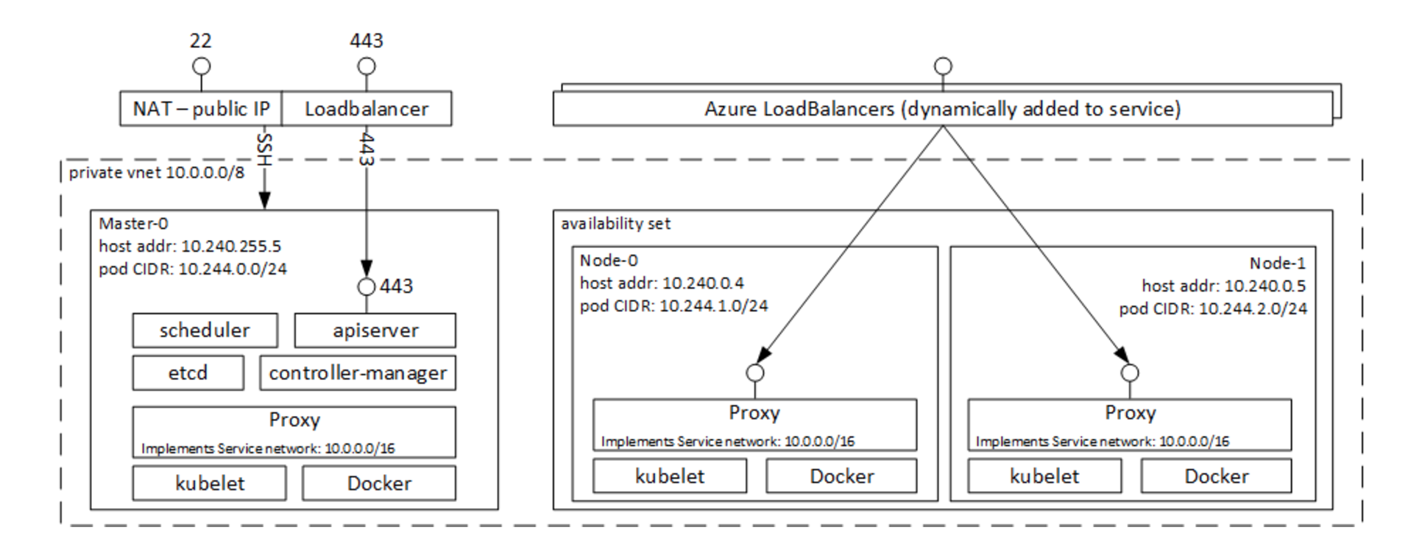
Azure Container Service Architecture (Kubernetes)

Slide 18
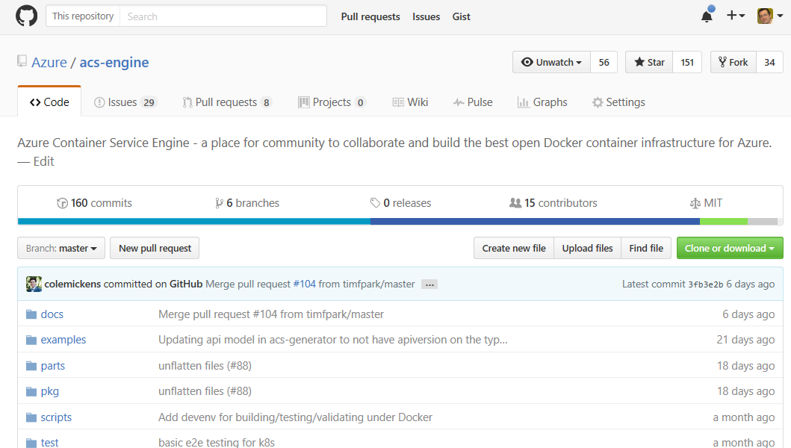
Contribute to the Future of ACS

Slide 19
Service Fabric

Slide 20




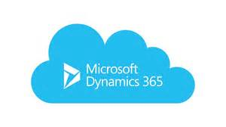

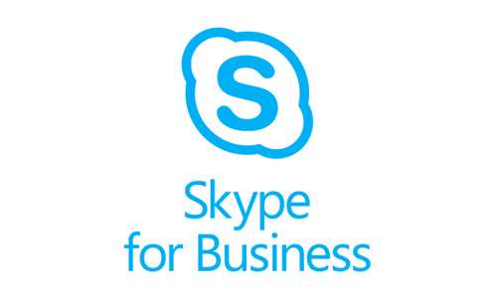

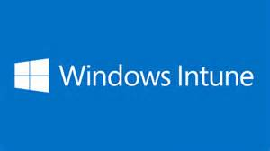
Services Powered by Service Fabric
Cosmos DB
Billions transactions/day
IoT Hub
Millions of messages
Event Hubs
60bn events/day
SQL Database
2.1 million DBs
Skype
Cortana
Intune
Dynamics
Power BI
Designed for mission critical tier 1 workloads
30% of Azure cores run Service Fabric

Slide 21
In the wild… go create a PaaS yourself!
Rolling Upgrades
Availability Guarantees
Scale Out Architecture
Resource Governance
Density
Packaging & Deployment
Policy Enforcement
Granular Versioning
Stateful Workloads
Leader Election
Mesos
Kubernetes
Zookeeper
Redis
Raven
MongoDB
Yarn
Fleet
Hadoop
Containers
?

Slide 22

An easier, battle-tested approach
Service Fabric
Rolling Upgrades
Availability Guarantees
Scale Out Architecture
Resource Governance
Density
Packaging & Deployment
Policy Enforcement
Granular Versioning
Stateful Workloads
Leader Election

Slide 23

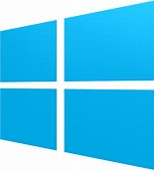


Azure Service Fabric
Any OS, Any Cloud
containers and microservices
Lifecycle
Management
Always On Availability
Programming Models
Health & Monitoring
Dev & Ops Tooling
Auto
scaling
Orchestration
Dev Machine
Azure
On Premise
Infrastructure
Other Clouds

Slide 24

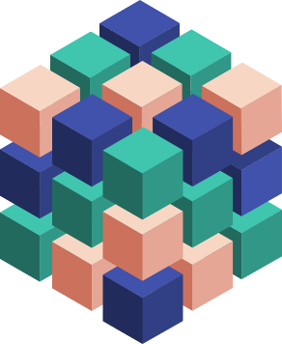
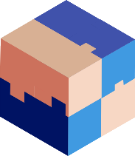



Modernize Applications
Lift & Shift
Modernize
Decompose
Transformed
Traditional app
Hosted as guest executables or containers in Service Fabric
Modernization by adding new microservices
Innovate by decomposing application into microservices
Transformed into microservices or new greenfield application
…You can stop at any stage

Slide 25


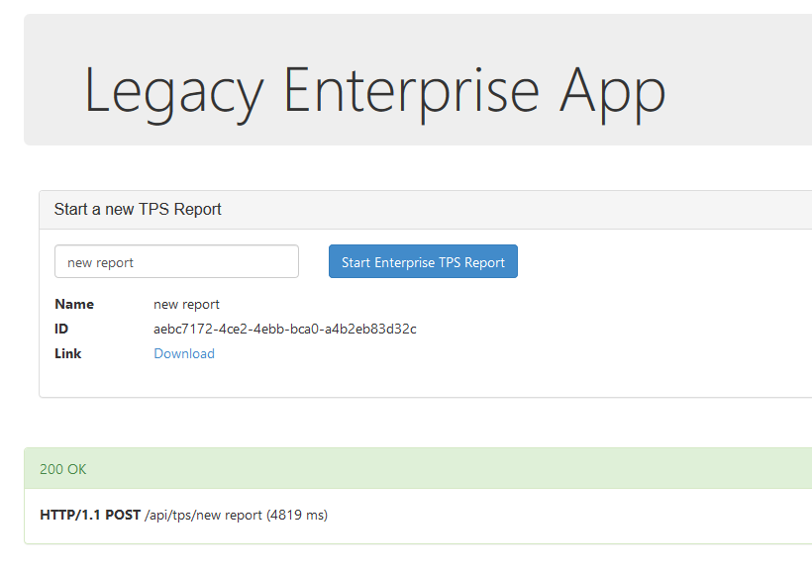


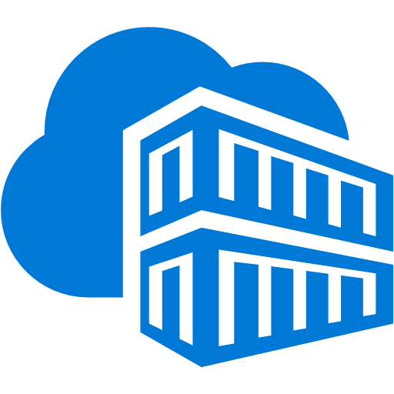
Legacy application: Lift-and-shift
Service Fabric cluster
Docker Compose
Front-end web service
container
Migrate
VSTS Git Repository
Azure Container Registry
SQL Server

Slide 26

Container Images
Image Contents
Registry
Folders and Files
My Website
Application
HKLM
inetpub
mysite.html
IIS
SOFTWARE/mykey
Application Framework
Image Contents
Registry
Folders and Files
HKLM
HKCU
License.txt
PerfLogs
Program Files
Base Image (OS)
HKCR
HKU
Program Files (x86)
Users
Windows

Slide 27
Typical Platform Services used by Containers
Azure Service Bus
Cosmos DB, SQL Azure
Redis Cache
OMS Monitoring

